Slide 1
Studying Thermoelectric Generators
Anastasija Cumika Physics Capstone Project 2018 Capstone Adviser: Dennis Sullivan

Slide 2
Project Overview
The main purpose of the project was to analyze thermoelectric generators (TEGs), so someone who is developing application for the TEGs could use this material.
To achieve this goal:
Theory on Seebeck Effect, TEGs and Heat transfer was studied
Out of the available materials, the best possible design for the electricity generating using TEG was created.
The outputs of the TEG were studied and analyzed under various conditions such as different loads, temperature differences, average temperatures and arrangements of the TEGs.

Slide 3
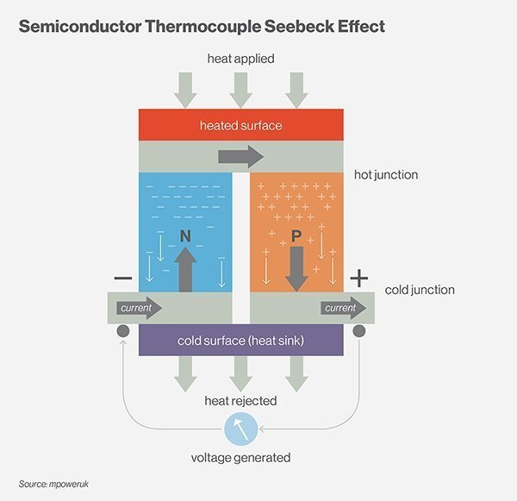


Seebeck Effect and ZT
Seebeck effect is the phenomenon when temperature difference between two junction of dissimilar electrical conductors produces emf (voltage).
The dimensionless figure of merit (ZT) shows how effective a specific material is for the thermoelectric performance.
$$ZT=\frac{α^{2}σ T}{k}$$
$$V=α∗∆T$$

Slide 4
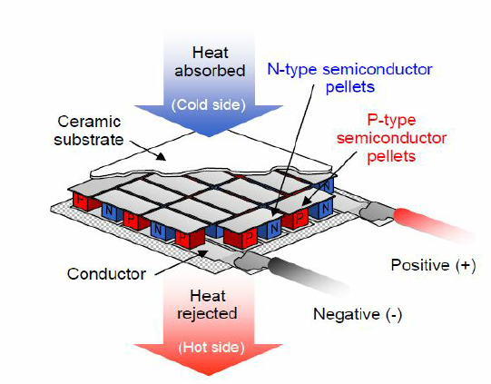
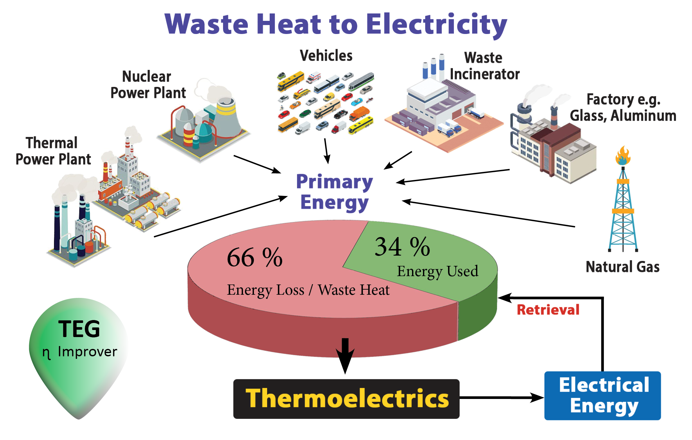
Thermoelectric Generator
TEG does not have any moving parts, has no noise or vibration and it is very compact and environmentally friendly.
The most popular material is Bi₂Te₃, which allows temperature up to 320 degrees Celsius.

Slide 5
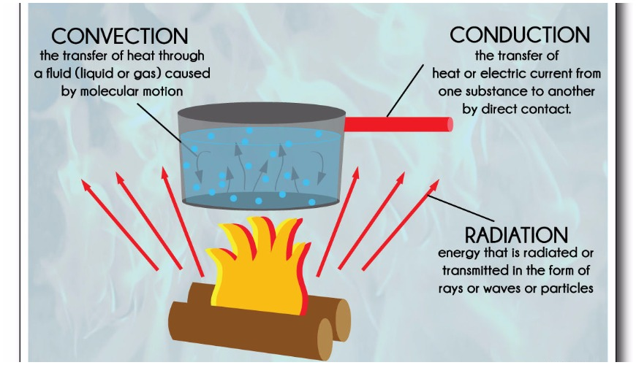


Heat Transfer
Two types of convection: forced and free (natural).
The conduction heat transfer is a result of the neighboring particles exchanging the kinetic energy through collisions.
Comvection current: hot fluid rises, more dense cold fluid drops -> Circular motion.
$$q=\frac{−k∗A∗∆T}{∆x}$$
$$q=−h∗A∗∆T$$
$$\text{Newton}\text{’}\text{s} \text{Law} \text{of} \text{Cooling}: T\left(t\right)=T_{s}+\left(T_{i}−T_{s}\right)∗e^{−kt}$$

Slide 6
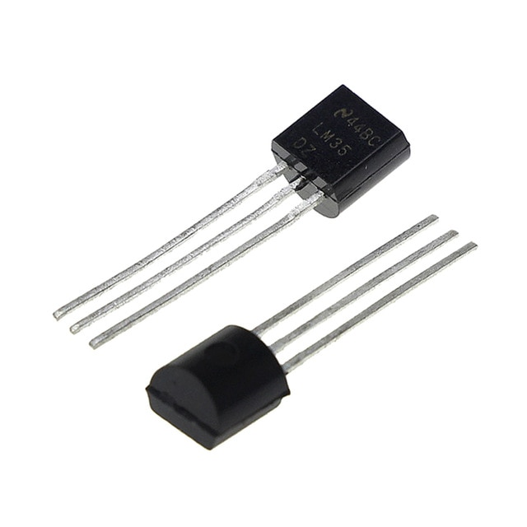
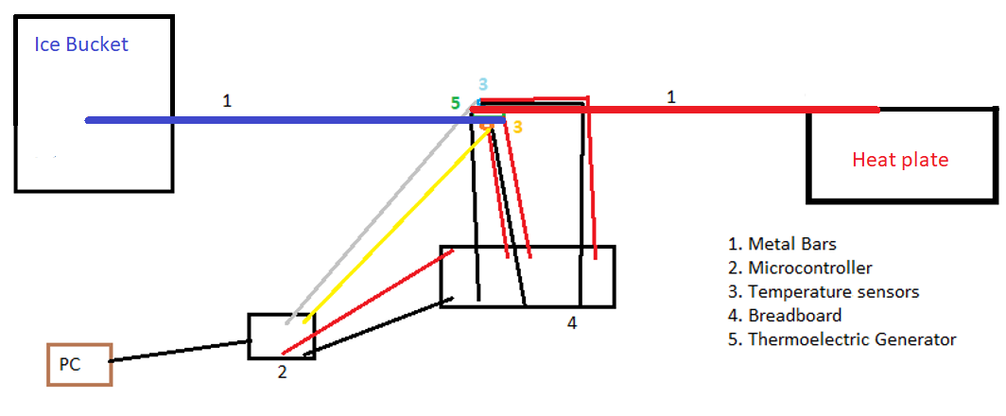

Data Collection
Temperature Sensor LM35
Geekcreit UNO R3 Microcontroller
“Master” Setup

Slide 7
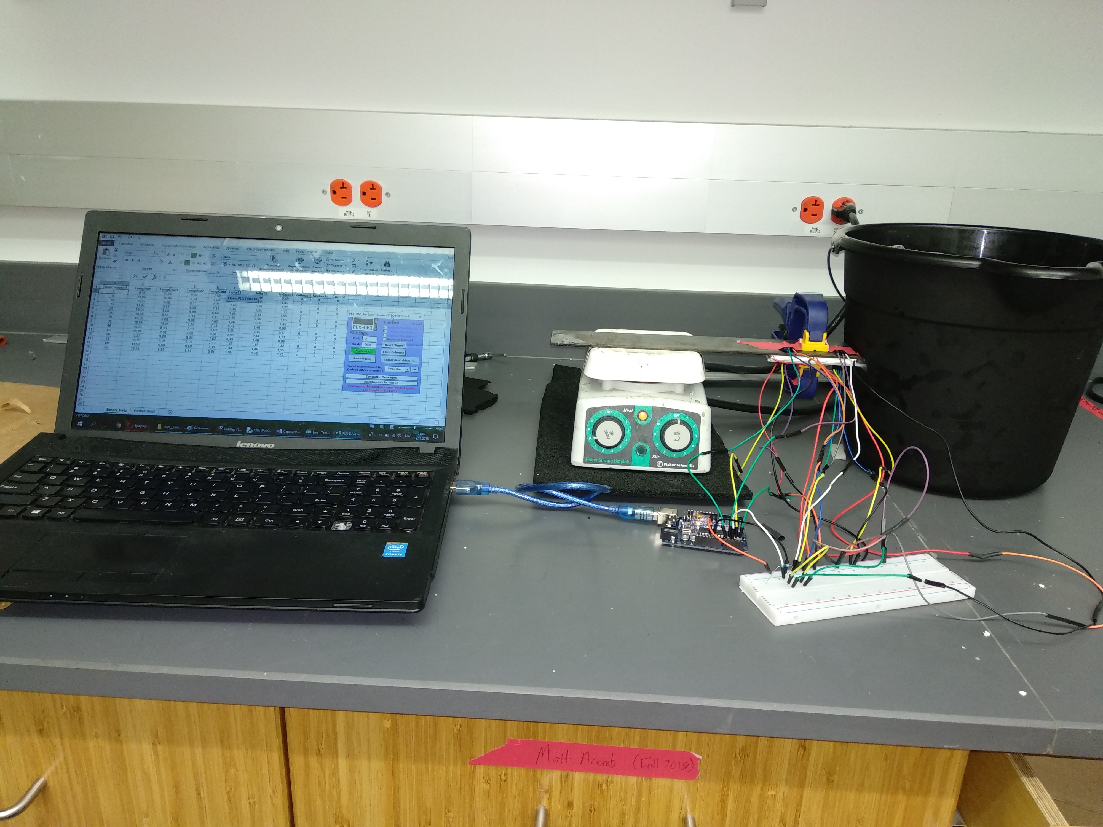
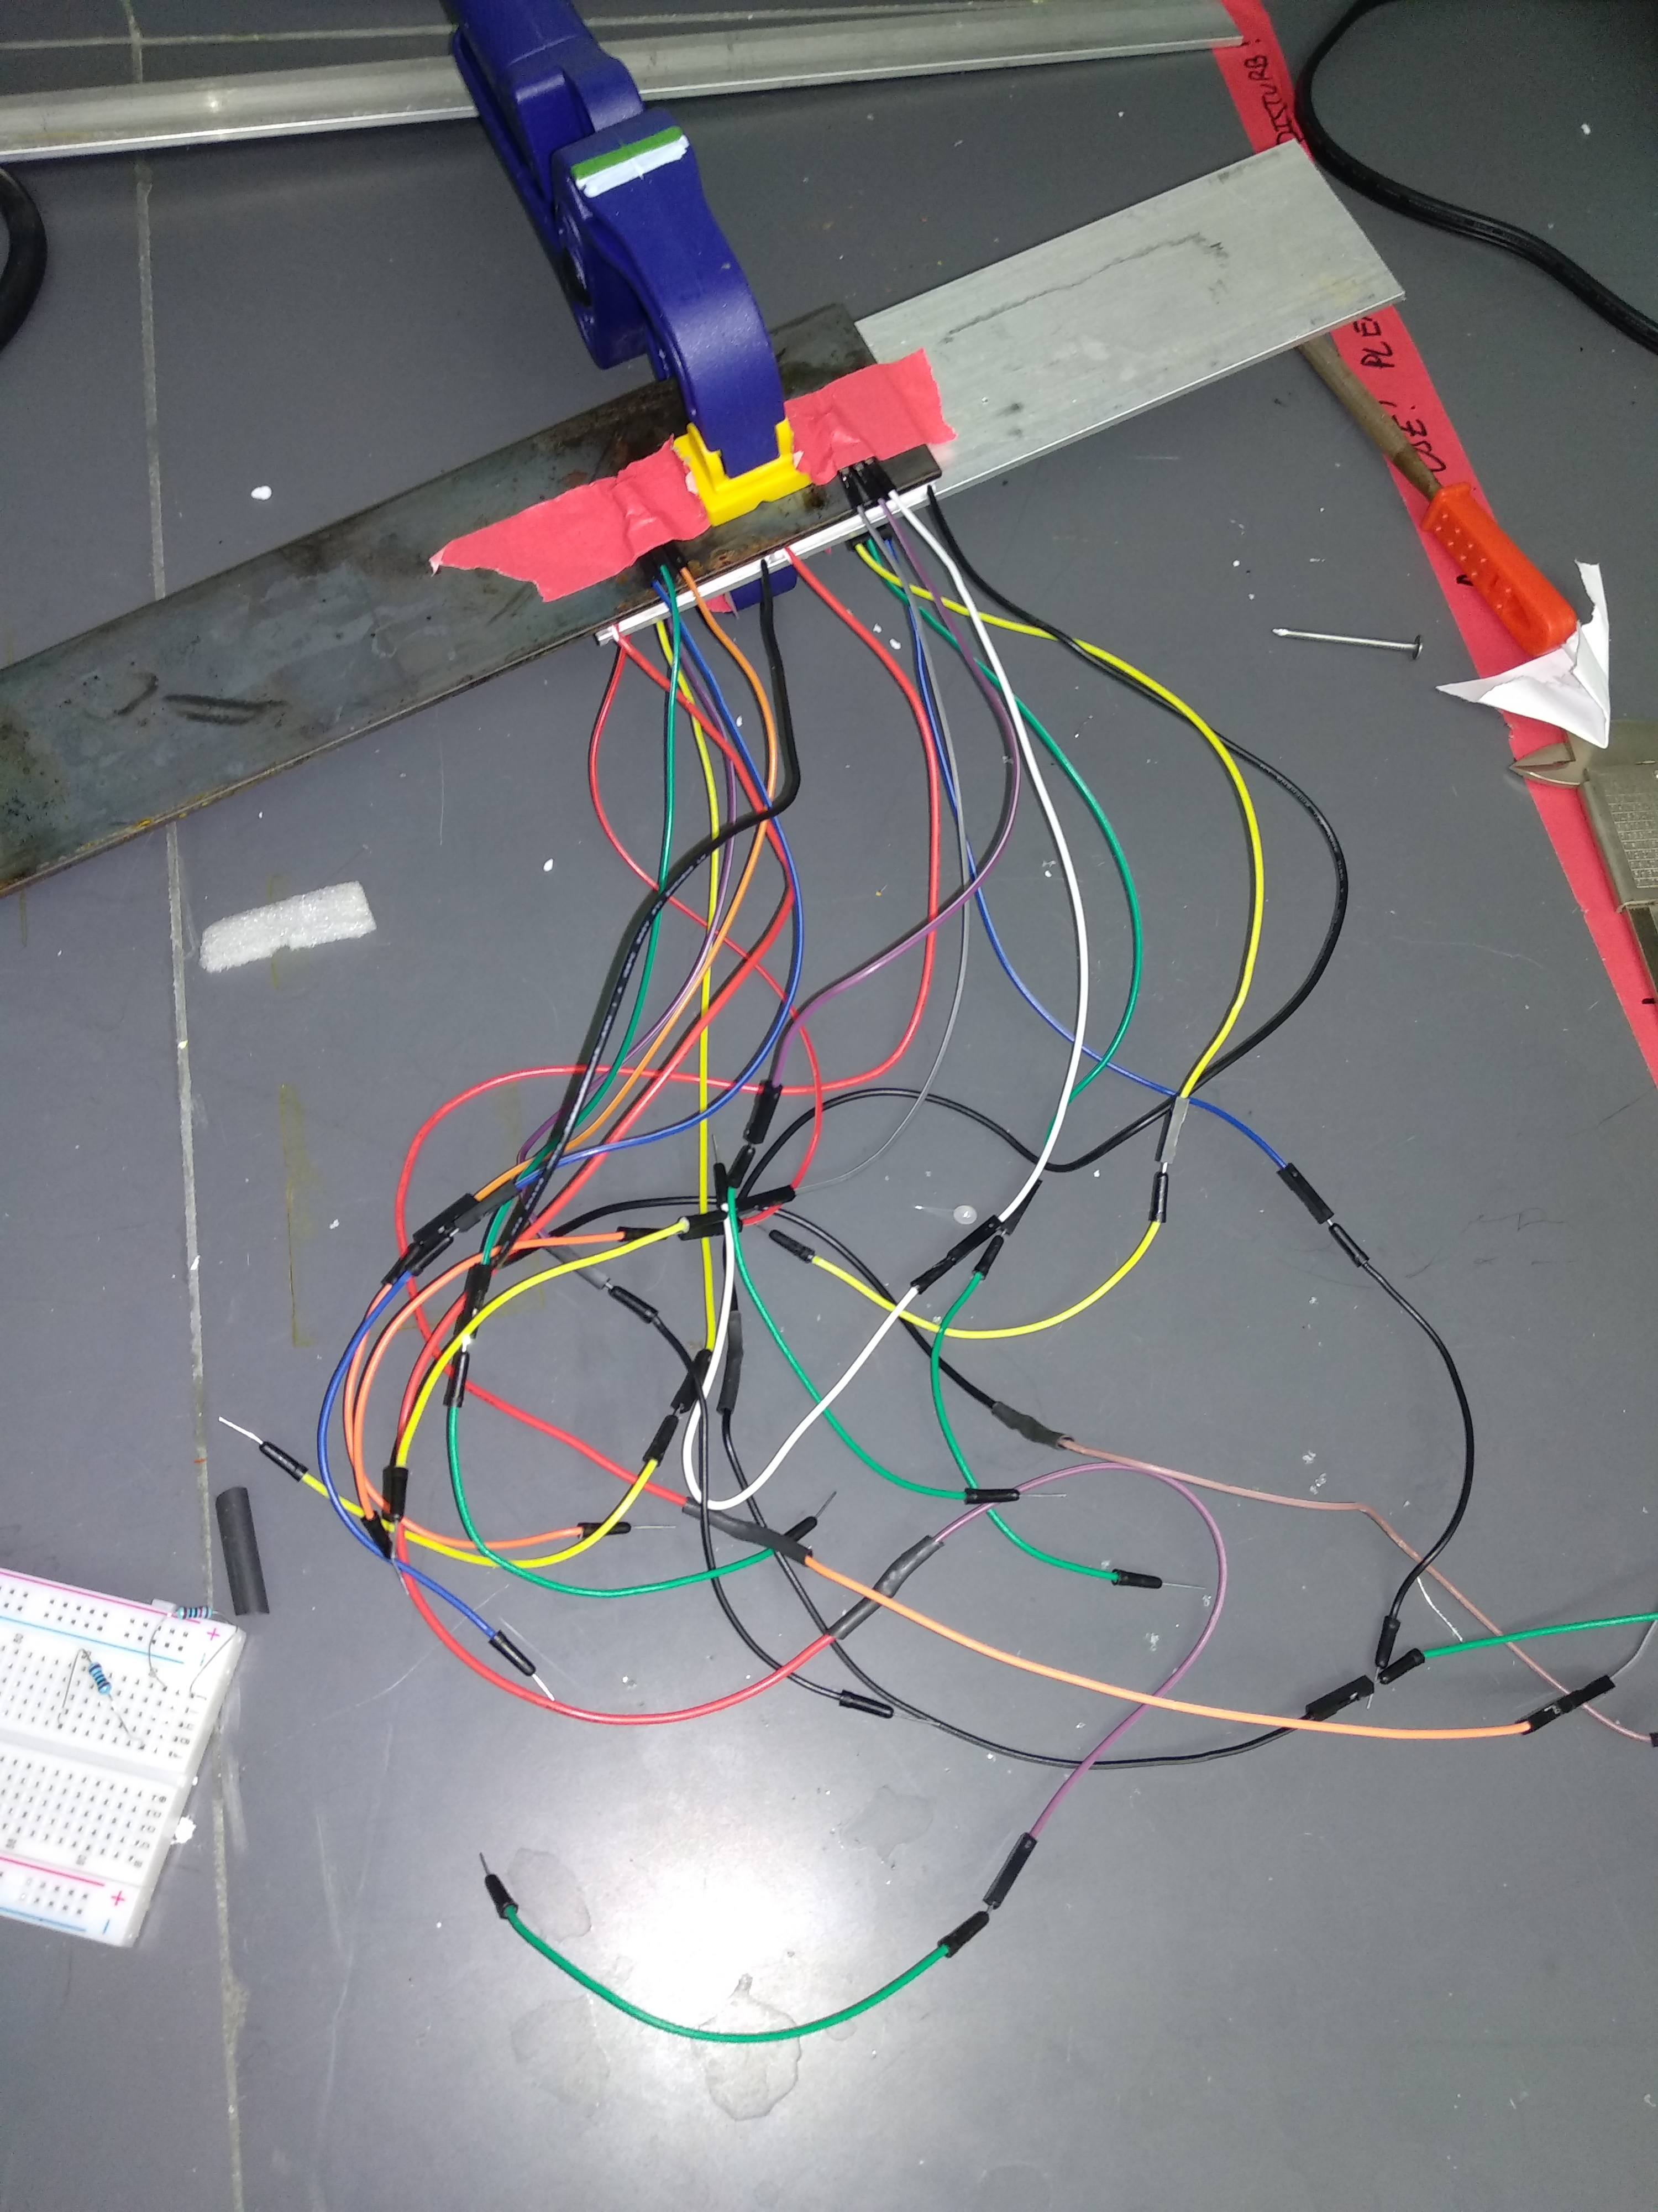
Example: Experiment with 2 TEGs

Slide 8
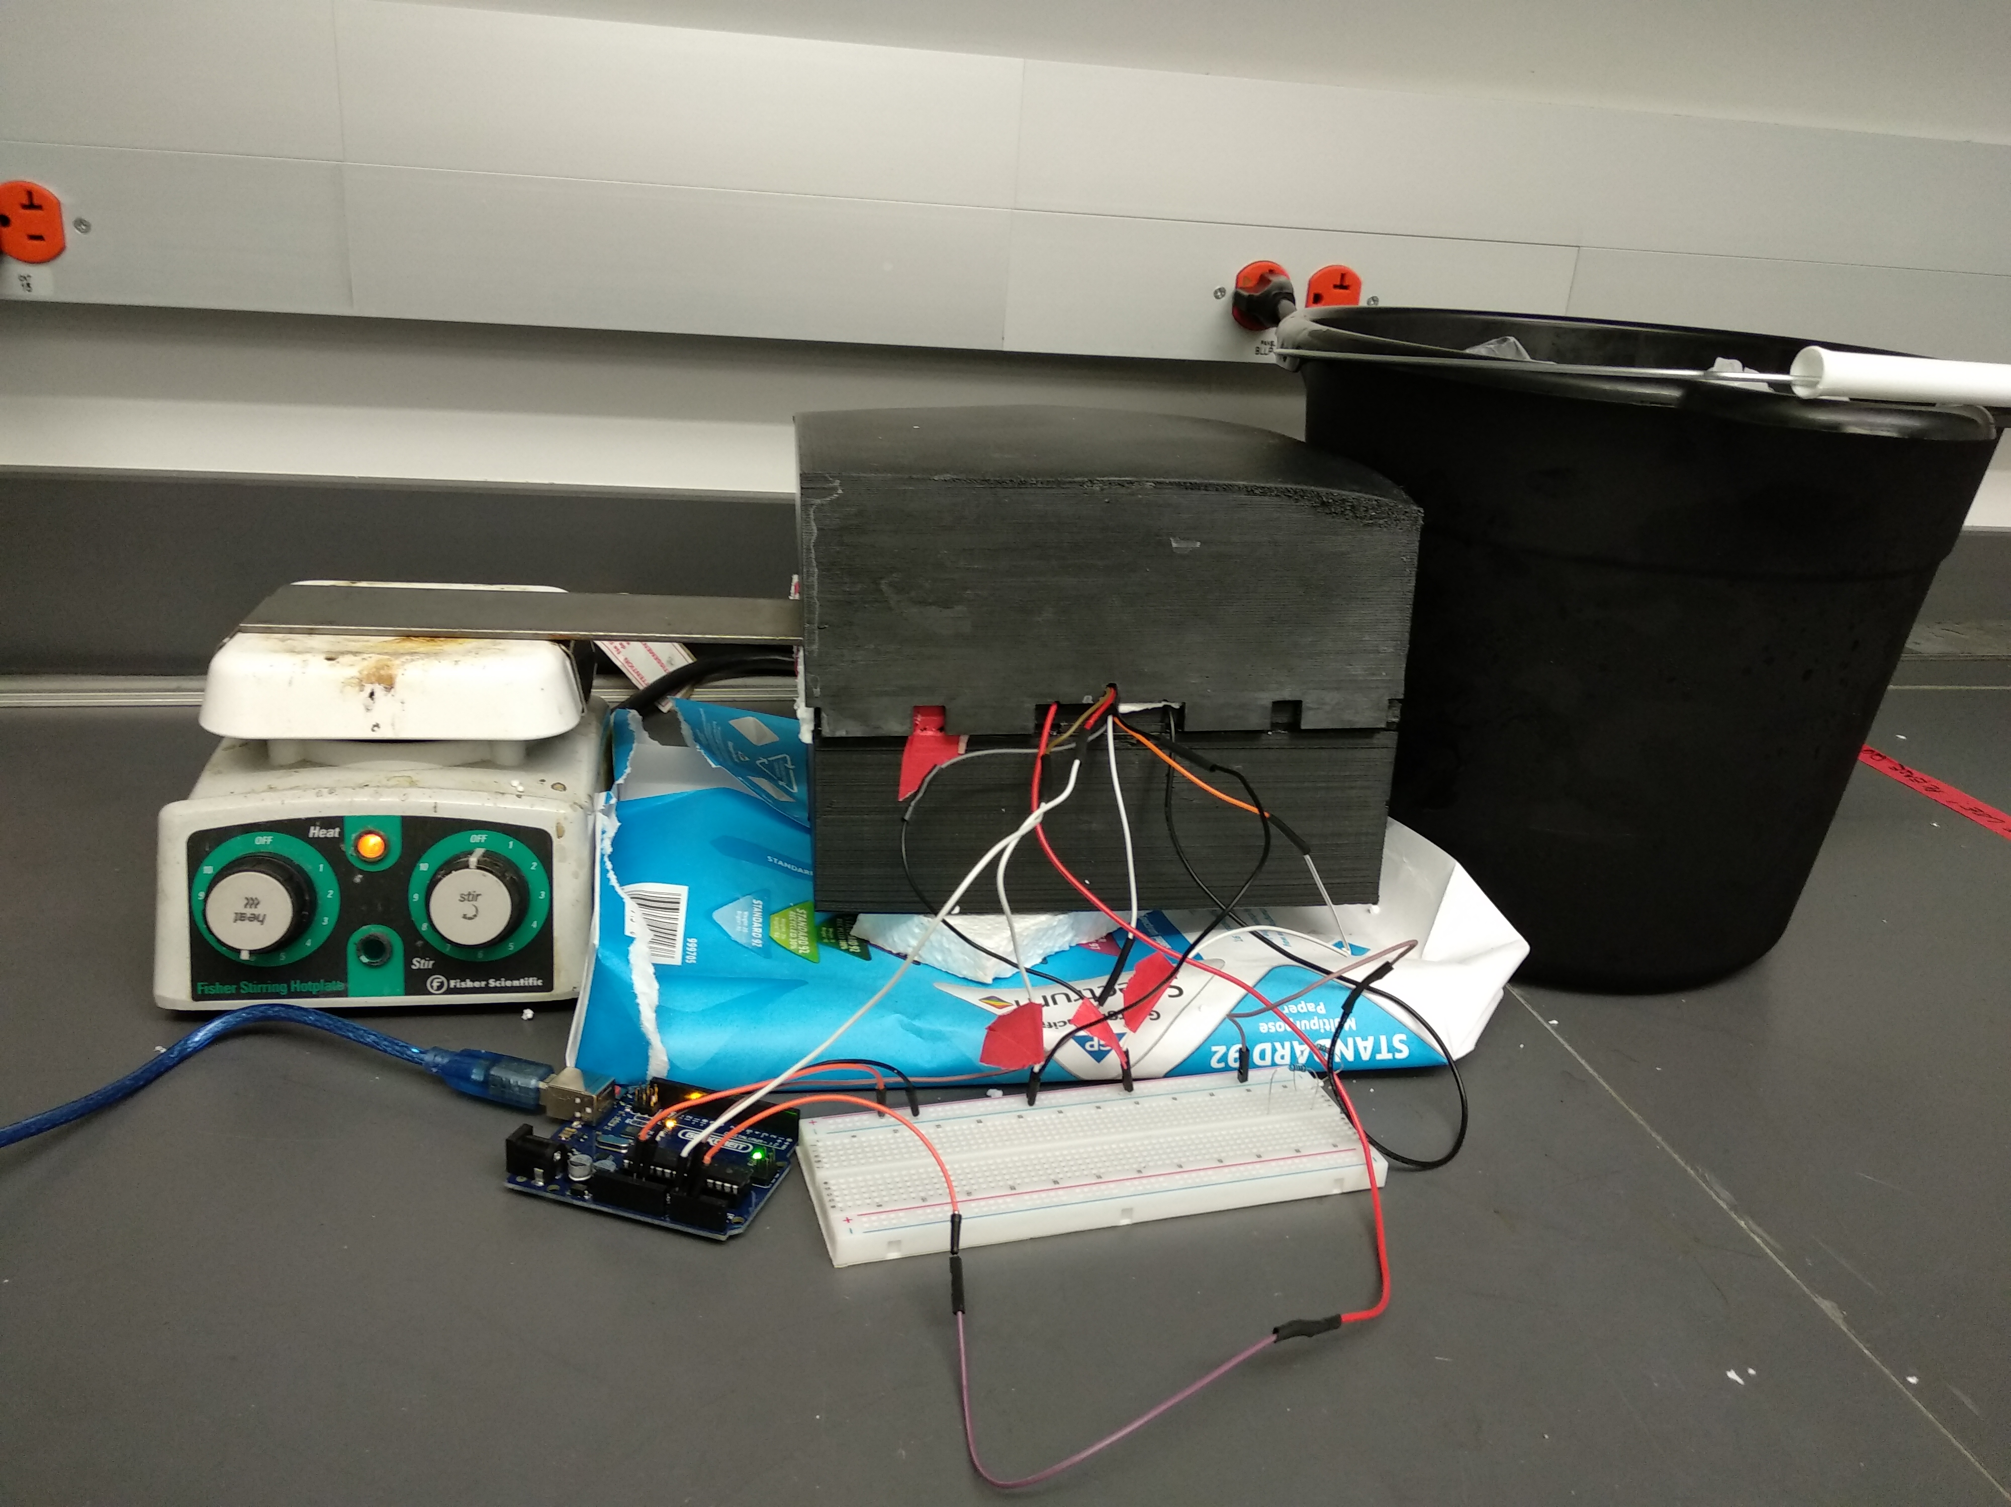
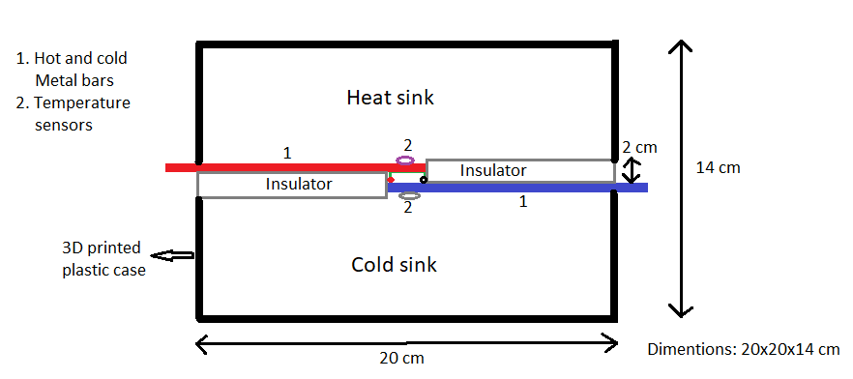
Does heat convection affect bars temperature?

Slide 9
Heat convection effect is negligible
The convention heat loss rate: -1.8 W
Conduction heat transfer from hot to cold bar through TEG is -141 W.

Slide 10
Materials for the bars

Slide 11
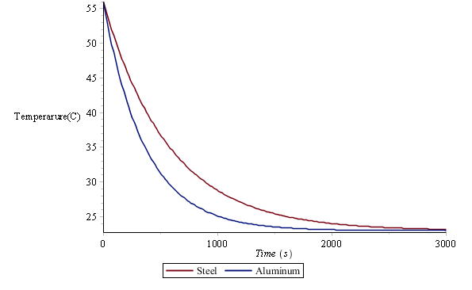
Theoretical Comparison of Steel and Alumimun
Aluminum bar transfers 12.8 times more heat energy per second then the steel bar
The difference in the cooling of the two materials is not as big as the difference in the heat transfer rate.
Newton's Law of Cooling

Slide 12
Different loads and TEG arrangements.

Slide 13
TEG Average Temperature Effect on Generated Voltage
ΔT determines the shape of the voltage graph, while average temperature acts as a scaling factor on the voltage graph.

Slide 14

TEG Resistance
Can’t measure resistance with multimeter, but we can calculate it from the data.
$$r=\frac{\left.R∗(V_{TEG}−V_{R}\right)}{V_{R}}$$
From PvsS run: 10.07 ohm
From 10k ohm long run: 8.06 ohm
The increased movement of the atoms increases the probability that electron will hit an atom on its way while going through the material -> increase of TEG internal resistance

Slide 15
Thank you

